Slide 1

Lung Cancer Detection; Comparative Study Between Different Models in Deep Learning
Anand Suraj
Guided By:
Purvi Tripathi
Sunil M K

Slide 2
Abstract:
Early diagnosis
Tissue analysis by pathologists.
Automated detection.
Classification models:
Convolutional Neural Network (CNN)
Residual Network (ResNet)

Slide 3
Problem Statements:
Appropriate deep learning models.
Parameters to evaluate the models.
Dataset selection.
Validation.

Slide 4
Objective:
Locate and isolate regions of interest.
Feature Extraction.
Classification.
Compare based on Metrics:
Accuracy
Efficiency

Slide 5
Existing Systems:
Radiology.
X-Rays.
Medical Professional Reviews
Positron Emission Tomography/ Computed Tomography (PET/CT).
DISADVANTAGES:
False positive.
Expensive.
Radiation exposure.
Time Consuming

Slide 6
Proposed System:
Automatic detection of cancer cells
Extraction of Region of Interest (ROI).
Classification.
ADVANTAGES:
Scalability.
Distributed.
Convenient.
Low Radiation.

Slide 7
Modules:
Datasets
Pre-Processing
Feature Extraction
Classification (Models Implemented)
Result
Accuracy

Slide 8
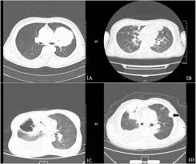
System Architecture Diagram:
File path extraction
Pre-processing
Noise removal
Image level extraction
Final detection
Model classifier
healthy
cancerous

Slide 9
Data Flow Diagram:
Input CT image
Pre-processing
Image path extraction
Train
image
Record
Tracking & prediction

Slide 10
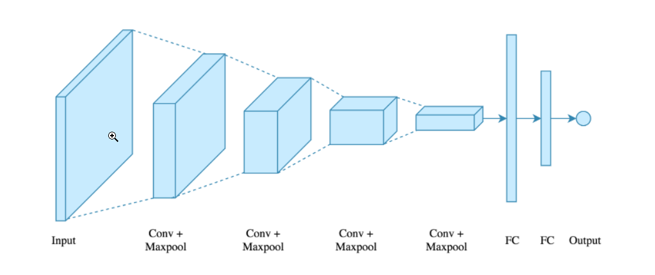
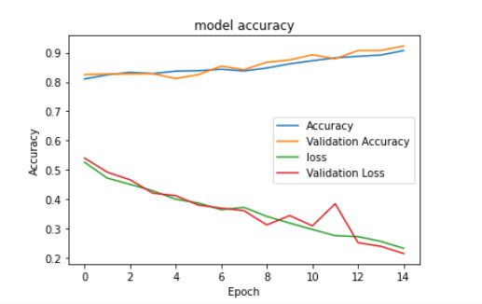
Model 1:
Convolutional Neural Network (CNN):

Slide 11
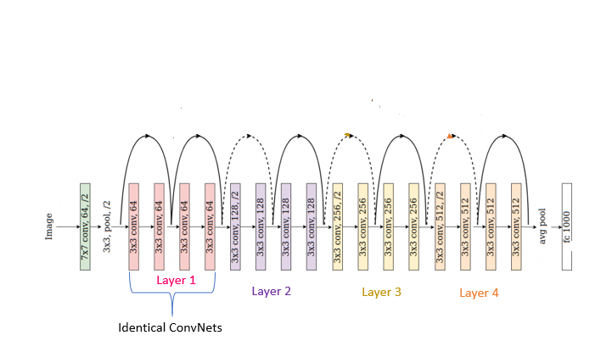
MODEL 2:
Residual Network (ResNet):
Epoch | Loss
0 | 1.505
1 | 1.53
2 | 0.851
3 | 0.86
4 | 0.77
5 | 0.73

Slide 12
Classifiers:
Serial Number | Classifier Name | Training Accuracy | Test Accuracy
1 | Support Vector Classifier | 0.94 | 0.92
2 | Xgboost Classifier | 1 | 0.92
3 | Random Forest Classifier | 1 | 0.92

Slide 13
Scope of the Project:
Scalability.
Replicable.
Modularity.
Ease of Modification.
Versatility.

Slide 14
Conclusion:
Successful implementation.
Variety.
Hybrid Models.
Scope for Improvement.

Slide 15
References:
https://luna16.grand-challenge.org/Procedure/
https://luna16.grand-challenge.org/Download/
https://github.com/felixpeters/lung-cancer-detection
https://aditi-mittal.medium.com/introduction-to-u-net-and-res-net-for-image-segmentation-9afcb432ee2f
https://towardsdatascience.com/understanding-and-visualizing-resnets-442284831be8
https://www.researchgate.net/publication/322476121_Anomaly_Detection_in_Nanofibrous_Materials_by_CNN-Based_Self-Similarity

Slide 16
Thank You

